Slide 1
API Validation Testing Using Karate
Niculiță Cristiana Teodora, Grupa 344
Duca Cosmina Elena, Grupa 333
Voinea Ana-Maria, Grupa 333

Slide 2
TABLE OF CONTENTS
01
02
03
04
05
06
07
08
Introduction
APIs
Automation and Manual Testing
Karate Framework
Cucumber Framework
Karate vs Cucumber
How Karate Works
Conclusion

Slide 3
01
Introduction

Slide 4
The article we are studying is about the Karate automation framework, developed in 2017, which aims to reduce testing costs and increase time efficiency in development and deployment phases. It is designed for API testing, performance testing, and UI automation, offering a user-friendly language, powerful assertions, and built-in multithreading capabilities. We will analyze the development of Karate for API testing, evaluating its performance and comparing it with the Cucumber BDD framework.
INTRODUCTION

Slide 5
Testing APIs
APIs or Endpoints serve as a message transfer link between back-end and front-end systems. When using APIs over a server, we need to ensure that the API is functioning as per contract.
Validate the API returns the expected status codes.
Every API upon execution returns a Status code. Status codes in the range 200-299 depict a successful request. Status codes in 400-499 and 500-599 represent client and server-side errors respectively.
Ensure API responses match predefined contracts.These contracts specify data formats, mandatory fields, and expected behaviors.
For example, we can specify in a response body that fields like Username and Email must be in string format, Age as an integer within a specific range, and that mandatory fields like Email must be included in every response.
Regularly monitor API performance and functionality.

Slide 6
02
Karate Framework

Slide 7
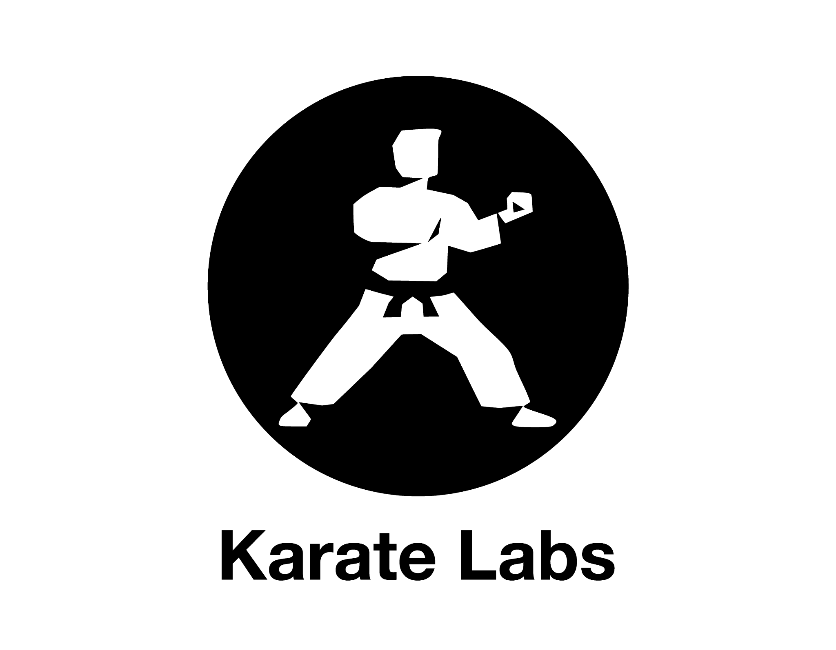
Karate is based on Cucumber, but doesn't require Java step definitions.
It has a similar syntax, but it's easier to use and integrates well with other softwares. This makes it a simple, powerful and flexible option for API validation testing.
Can handle complex schemas and quickly test endpoints using multiple threads. Its simple syntax helps developers write tests faster. This efficiency, along with parallel execution, makes Karate a suitable choice for regular testing on cloud platforms.

Slide 8
03
Cucumber Framework

Slide 9

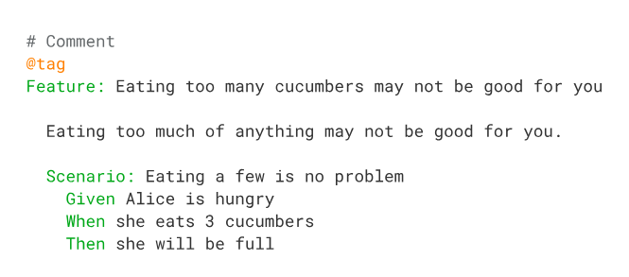
CUCUMBER FRAMEWORK
The Cucumber framework is a Behavior Driven Development (BDD) tool that uses natural language syntax to create test scripts. It helps product owners or business analysts to understand better what are the tests about. It follows a given, when, then syntax, which is written using natural language. It might looks very easy to understand, but behind those words, the developer must supply more definitions in the backend code in Java to automate these steps.
Figure 1. Cucumber test script

Slide 10
04
Karate VS
Cucumber

Slide 11
CUCUMBER VS KARATE
FRAMEWORK | CUCUMBER | KARATE
Syntax
Backend Integration
Parallelism
Step Definitions
The tests using Karate framework has much many advantages than Cucumber framework.

Slide 12
CUCUMBER VS KARATE FRAMEWORK
Parallelism
Syntax and Language
Cucumber itself doesn't provide built-in support for parallel test execution.
Karate supports parallel execution of tests out-of-the-box. It automatically runs feature files concurrently, making it easy to execute tests in parallel without any additional configuration.
Cucumber tests are written in the Gherkin language, based on a schema like Given, When, Then to describe test scenarios in a human-readable format.
Karate tests are written in a domain-specific language (DSL) inspired by Gherkin but with its syntax for expressing test scenarios. Karate allows you to write tests directly in the feature files, eliminating the need for separate step definition files.
Step definition
In Cucumber, step definitions are separate code files where the actual implementation of test steps is written in programming languages like Java.
Karate eliminates the need for separate step definition files by allowing you to define test steps directly in the feature files.

Slide 13
05
Results & More

Slide 14
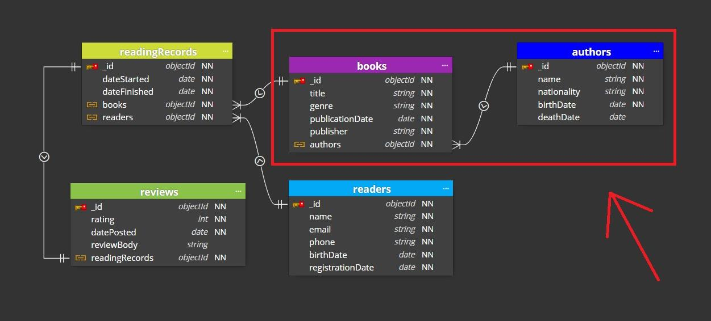
Diagram of the Tested Project

Slide 15
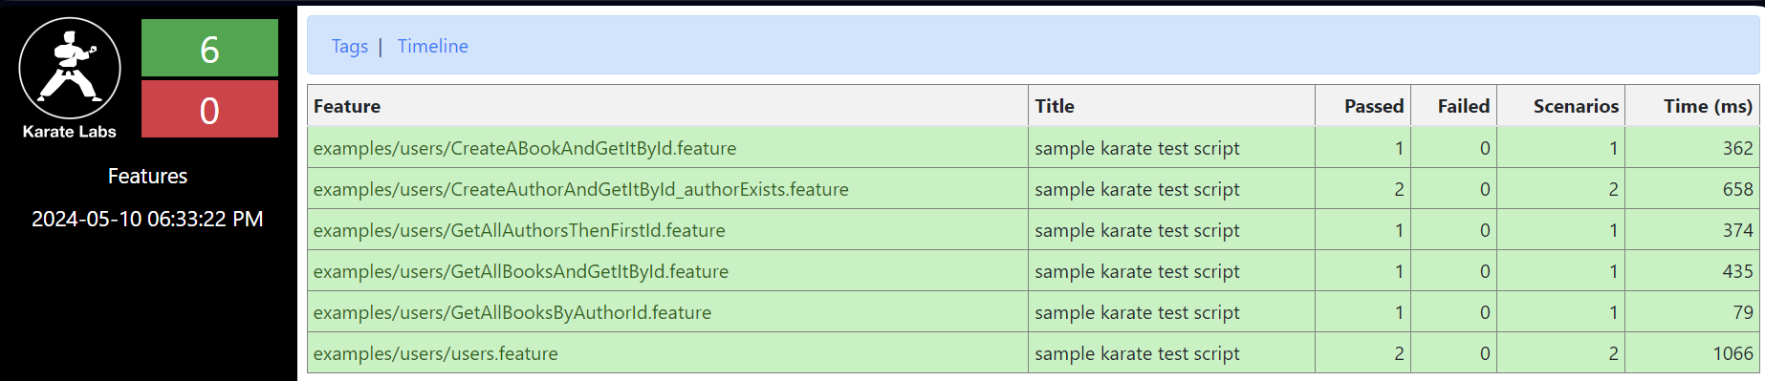
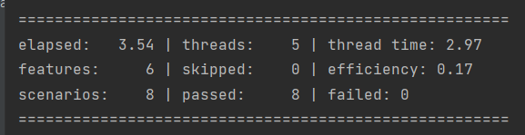

Karate results

Slide 16
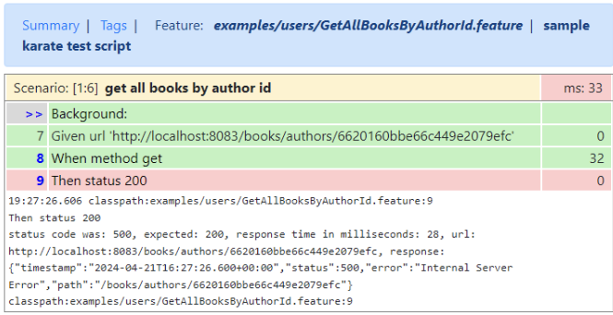
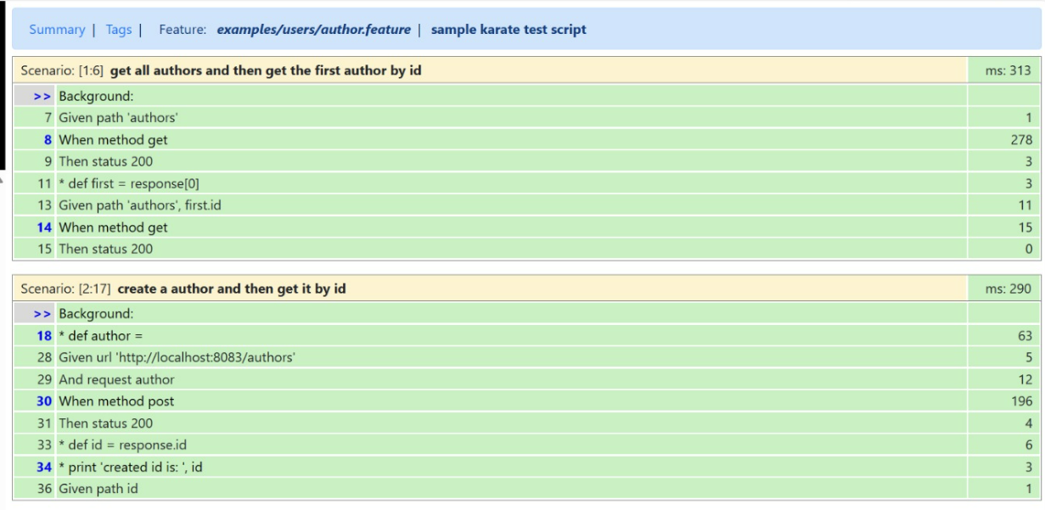
Karate results

Slide 17

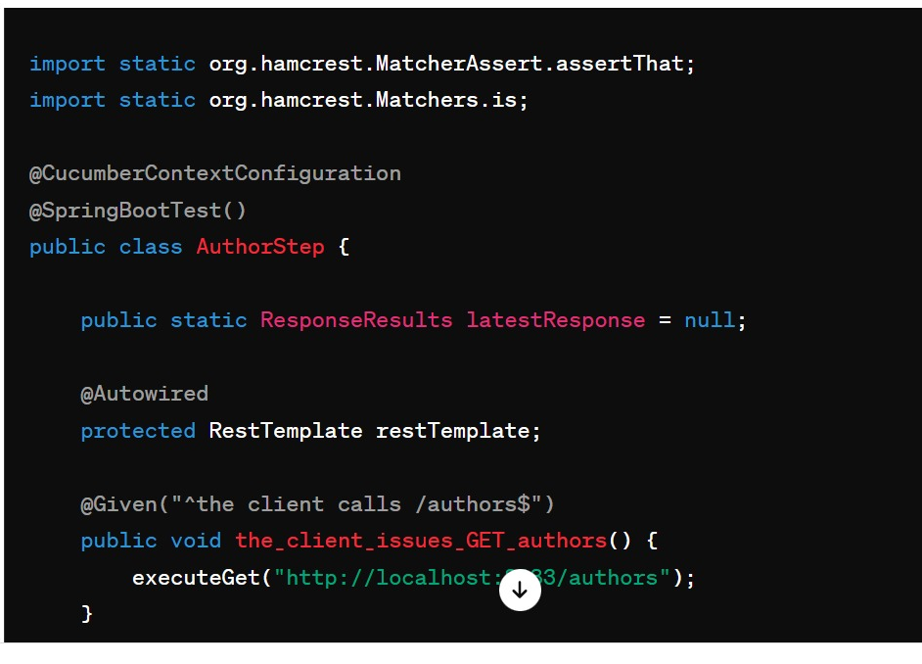
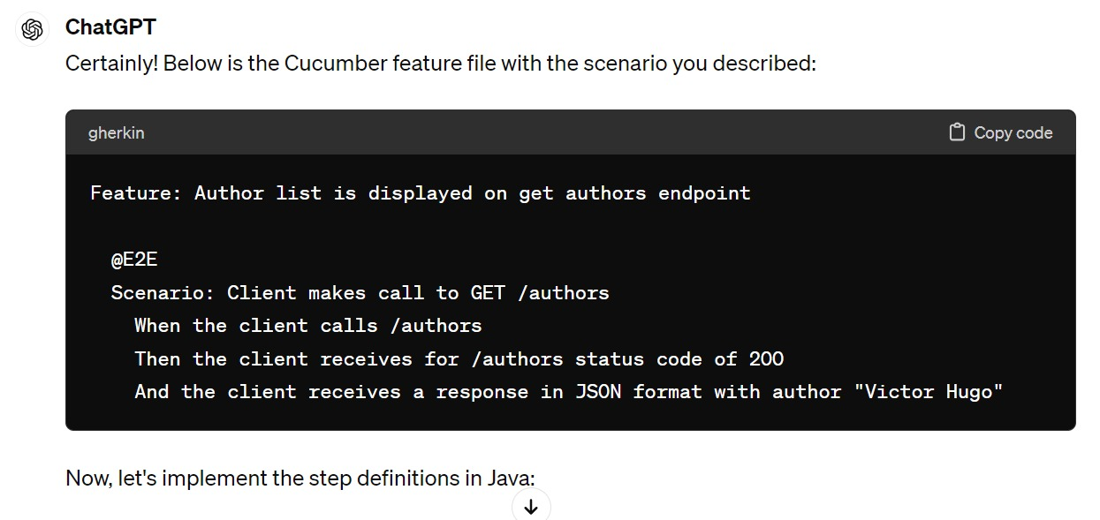
Cucumber scenario generated by ChatGPT

Slide 18
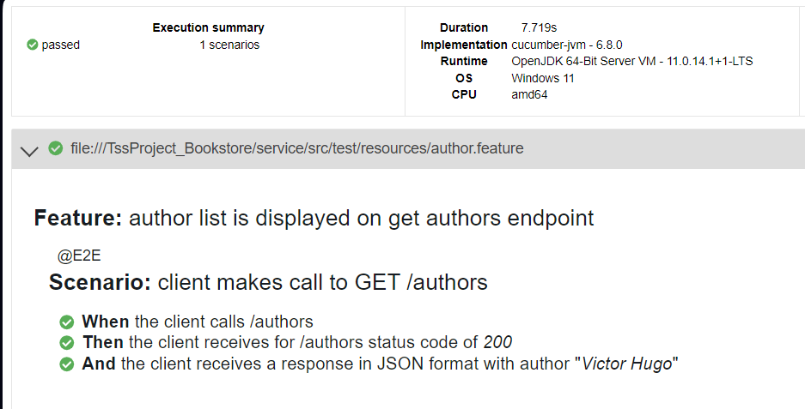
Cucumber Results

Slide 19
06
Conclusion

Slide 20
MULTUMIM

